Slide 1


Design of High-Gain and Beam Steering Antennas Using a New Planar Folded-Line Metamaterial Structure
TEAM MEMBERS :
GUIDED BY
Dr.P.JEYAKUMAR,
ASSISTANT PROFESSOR,
ECE DEPARTMENT.
YUVAPRABHA.B (927621BEC247)
SREVARSHINE.S (927621BEC208)
SUJITHA.V (927621BEC222)
SOBIYA.T (927621BEC205)

Slide 2
INTRODUCTION :
What is Beam steering?
What is meant by meta material?
What is the difference between normal patch antenna and the meta material?

Slide 3
PROBLEM STATEMENT
The material output that is radiation pattern has been radiated in all radiation .
To avoid this we can go for with Beam Steering concept.
We proposed a novel structure of planar folded-line metamaterial and applied it to improve the gain of 5.8 GHz microstrip antenna types: a circularly polarized patch antenna, an antenna array, and a beam steering antenna.

Slide 4
OBJECTIVES
Isolation improvement of 4 dB is achieved by keeping the meta- material structure in between the MIMO elements.
With the proposed struc- ture, the isolation is achieved around 24.5 dB.
Due to low ECC, high gain, low channel capacity loss and very low mutual coupling between elements, the proposed antenna is a good candidate for the MIMO applications.

Slide 5
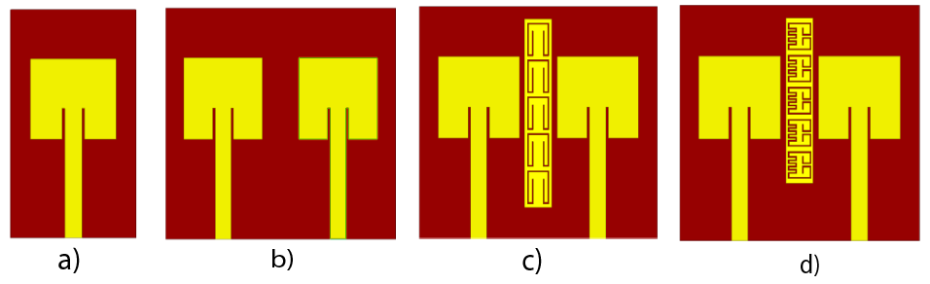
Steps involved in the proposed system

Slide 6
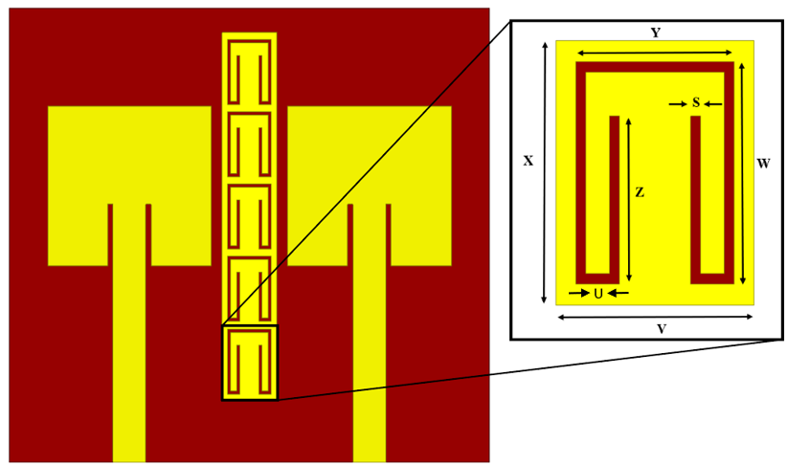
Existing System
The existing antenna is printed on a low cost FR-4 substrate having a loss tangent and relative permittivity of 0.02 and 4.4, respectively.
The existing design has two patches excited using a 3 mm wider microstrip lines with a 50 Ω characteristic impedance.

Slide 7
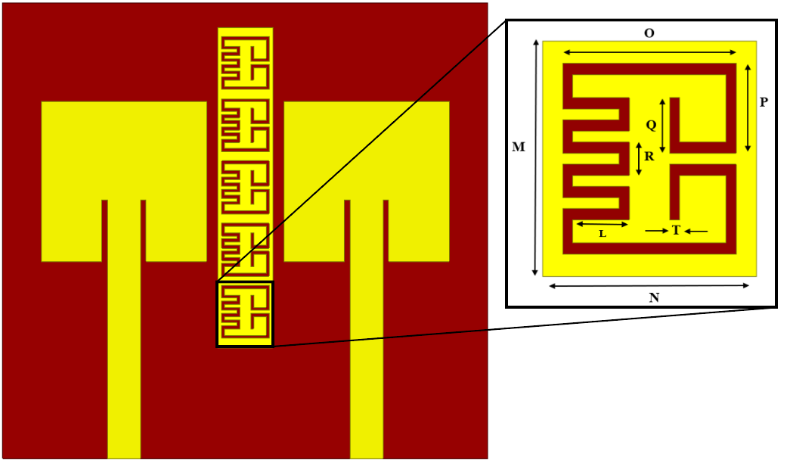
Proposed System
Width and length of the optimized antenna were chosen as 15 mm and 13 mm respectively. Secondly, another patch antenna is designed near to the first one with the length and width of the substrate is 77 mm and 22 mm.
This has done for achieve the high gain and increase the antenna efficiency. These two patches are separated with the small distance of 5.3 mm.

Slide 8
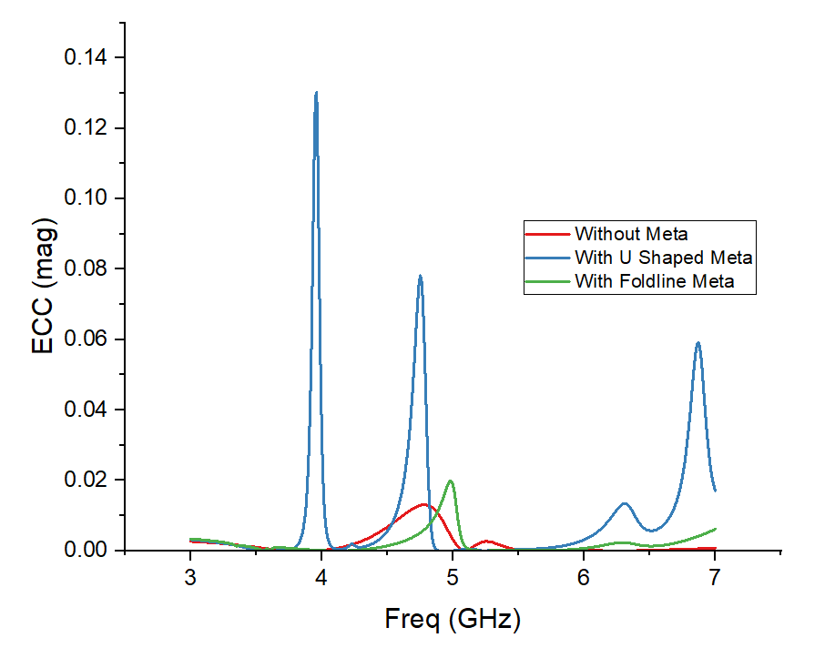
Comparison
The ECC is around the ideal value and it is equal to 0.02 at 5.8 GHz. Furthermore, it is clear from the same figure that the ECC is less than 0.1 over the operating frequency band.

Slide 9
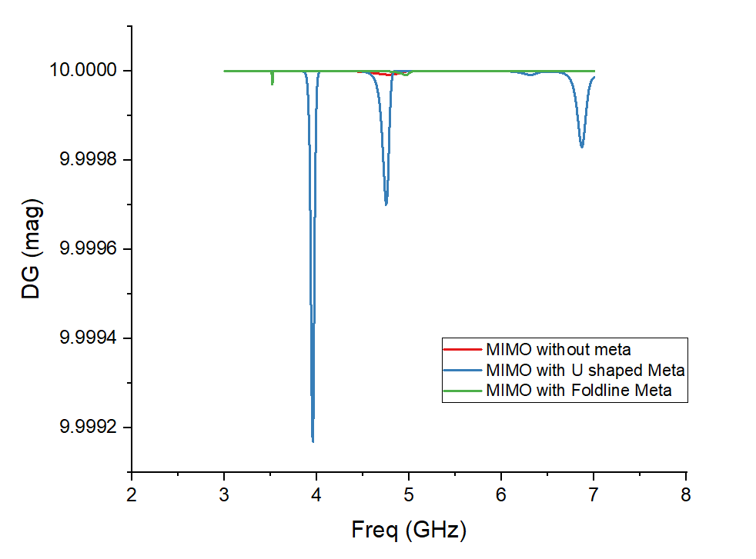
At 5.8 GHz, the proposed MIMO antenna attained a DG of 4.05 dB. Yet, the proposed antenna has a DG <5.8 dB over the entire operating band.

Slide 10
Conclusion
In this paper, a new planar FL-LHM structure is pre- sented. An equivalent circuit is useful for understanding and designing a FL-LHM substrate for an arbitrary operating frequency.
In addition, the FL-LHM modeling is created for easy simulation using electromagnetic software and for enhancement antenna gain. In consequence, the new FL- LHM substrate is used to increase the gain of three types of low-profile antennas which are the circularly polarized rectangular patch antenna, the antenna arrays, and the beam steering antenna.

Slide 11
References
[1] Sharawi, M.S.: Printed multi-band mimo antenna systems and their perfor- mance metrics [wireless corner]. IEEE Antennas and propagation Magazine 55(5), 218–232 (2013)
[2] Shams, K.M., Ali, M.: A cpw-fed inductively coupled modified bow-tie slot antenna. In: 2005 IEEE Antennas and Propagation Society International Symposium, vol. 3, pp. 365–368 (2005). IEEE.
[3] Simovski, C.R.: Plane-wave reflection and transmission by grids of con- ducting ω-particles and dispersion of ω electromagnetic crystals. AEU- International Journal of Electronics and Communications 57(5), 358–364 (2003).

Slide 12


